Slide 1

A
Project Report On
Airlines ticket Booking System
Developed By
Parmar Smita(5102)
Solanki Kinjal(5053)
Zanzarukiya Vidhi(5110)
(Sem-V Bachelor of Computer Applications)

Slide 2

Navgujarat College of Computer Applications
Ashram Road, Ahmedabad
Internal Guide
Pro.Ankita Patel

Slide 3

Content:
The Airline Ticket Booking System is a web-based application designed to simplify the process of booking flight tickets online. It provides users with real-time flight availability, seat selection, and secure payment options
In the traditional system, customers often have to visit travel agencies or airline offices to check flight availability, compare fares, or reserve seats. This method is time-consuming, prone to errors, and lacks real-time updates. To overcome these challenges, an efficient computerized system is required.

Slide 4
SYSTEM FLOW DIAGRAM
System flow diagram is a basically a graphical and sequential representation of the major steps involved in a systematic process.
Symbols of system flow diagram
❖ Start/End point
An oval represents a start or end point. The terminator symbol marks the starting or ending point of the system. It usually contains the word “Start” or “End”.
❖ Arrows
A line is a connector that shows relationships between the representative shapes.

Slide 5
❖ Process
This shape is rectangle. A rectangle represents a process In system flow diagram.
❖ Decision
A diamond indicates a decision. It appoints where the outcome of a decision dictates the next step. There can be multiple outcomes, but often there are just two – yes and no or true – false, then branches to different parts of the system flow diagram.

Slide 6
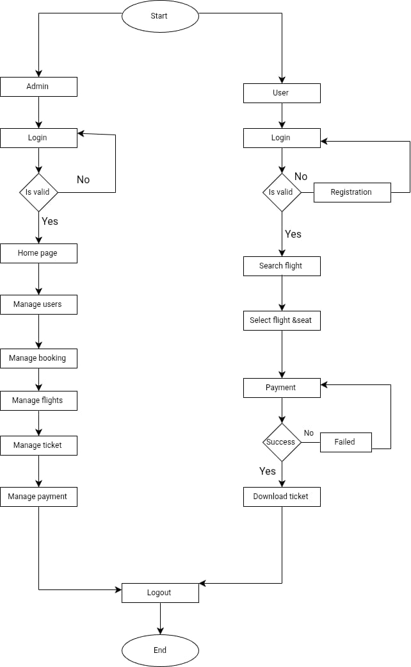
System flow diagram

Slide 7
UML(UNIFIED MODELLING LANGUAGE)
• What is UML and it’s use?
Unified Modelling Language (UML) diagrams are graphical representation used for system design to illustrate various aspects of system. The overall goal of UML diagrams is to allow teams to visualize how a project is or will be working. UML can be used to develop diagrams and provide users with ready-to-use expressive modelling examples.
• What is the need of UML Diagrams?
An UML Diagrams are basically used in software engineering and other business processes where modelling is useful. UML becomes essential to communicate with non- programmers’ essential requirements, functionalities, and processes of the system.

Slide 8
Types of UML Diagram:-
• Use Case Diagram:
An UML use case diagram is the primary form of system/software requirements for a new software program underdeveloped.
• Activity Diagram:
An activity diagram is used by developers to understand the flow of programs on a high level.
• Sequence Diagram:
sequence diagrams is used to document and understand the requirements to establish new systems or learn about existing systems.
• Class Diagram:
Class Diagram is a type of static structure diagram that describes the structure of a system by showing the system's classes, their attributes, operations (or methods), and the relationships among objects.

Slide 9
USE-CASE DIAGRAM
Symbols of use case diagram
❖ Use-Cases
Draw use cases using ovals. label the ovals with verbs that represent the system’s functions.
❖ Actors
Actors are the users of a system. When one system is the actor of another system label the actor system with the actor stereotype.

Slide 10

❖ System Boundary
Draw the system’s boundaries using a rectangle that contains use cases, place actor outsides the system’s boundaries.
❖ Relationships
Illustrate relationships between an actor and a use case with a simple line. For relationship among use cases, use arrows labelled either “uses” or “extends”. A “uses” relationship indicates that one use case is needed by another in order to perform a task.
<<include>>
<<extend>>
An “extends” relationship indicates alternative options under a certain usecase.

Slide 11
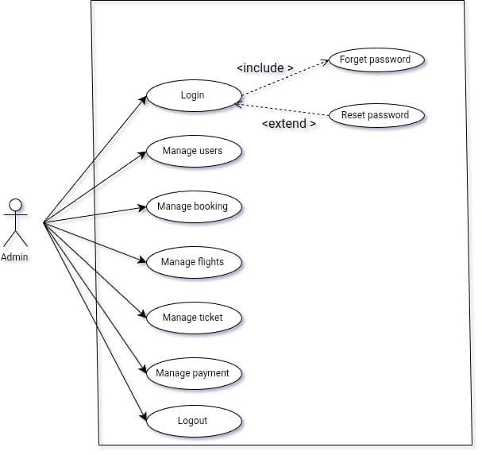
Use case diagram for admin

Slide 12
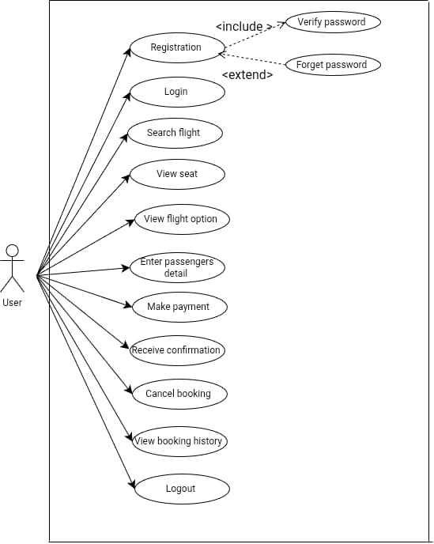
USE-CASE DIAGRAM FOR USER

Slide 13
SEQUENCE DIAGRAMS
What is Sequence Diagram?
Sequence diagram is an interaction diagram which focuses on message interchange between number of timelines.
It represents the flow of messages in the system and can also be termed as Event Diagram.
It illustrates how the different parts of a system interact with each other to carry out a function, and the order in which the interactions occur when a particular use case is executed.

Slide 14
Benefits of Sequence Diagram:
Following are some advantages of sequence Diagram:
Sequence Diagram is used for high-level interactions hence helps in understanding
developers design and complex system.
It has easy maintenance.
It depicts the message flow between the different objects.
It can easily update as per the new change in the system.

Slide 15


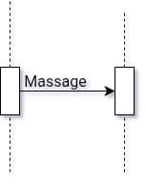
Symbols of Sequence diagram
❖ Actor
It represents the role, which involves human users and external hardware or subjects.
❖Activation
It describes the time in which operations are performed by elements.
❖ Call message
This show both the call and the reply of the message.

Slide 16
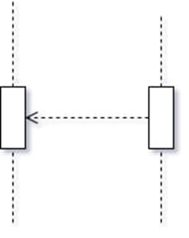
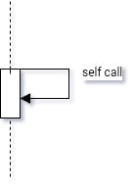
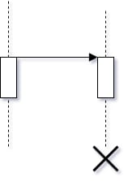
❖ Return message
This shows the replies to the messages.
❖ Self message
This shows the interactions between the same lifelines.
❖ Destroy message
Destroy message is a kind of message that represents the request of destroying the lifecycle of target lifeline.

Slide 17
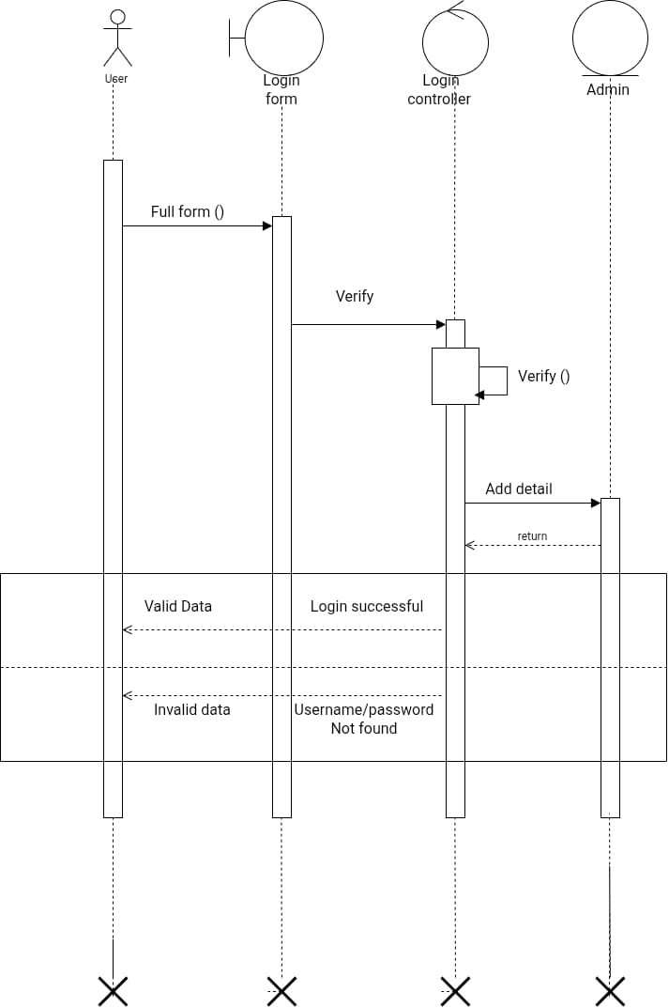
Login

Slide 18
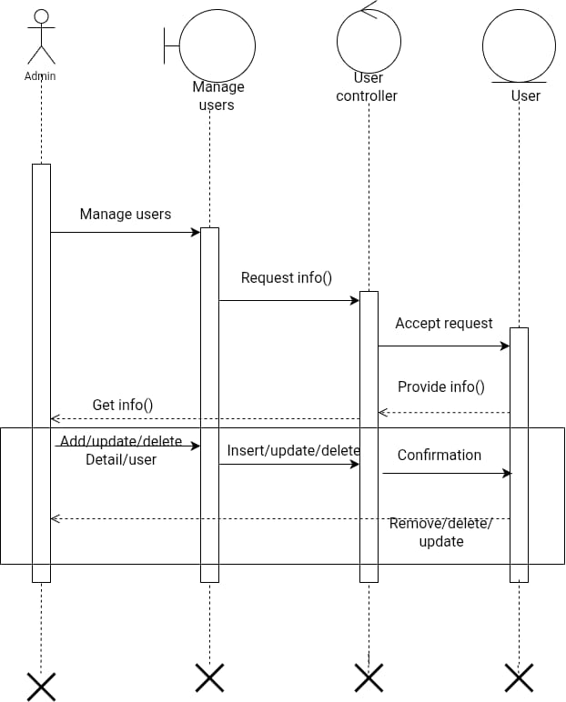
Manage users

Slide 19
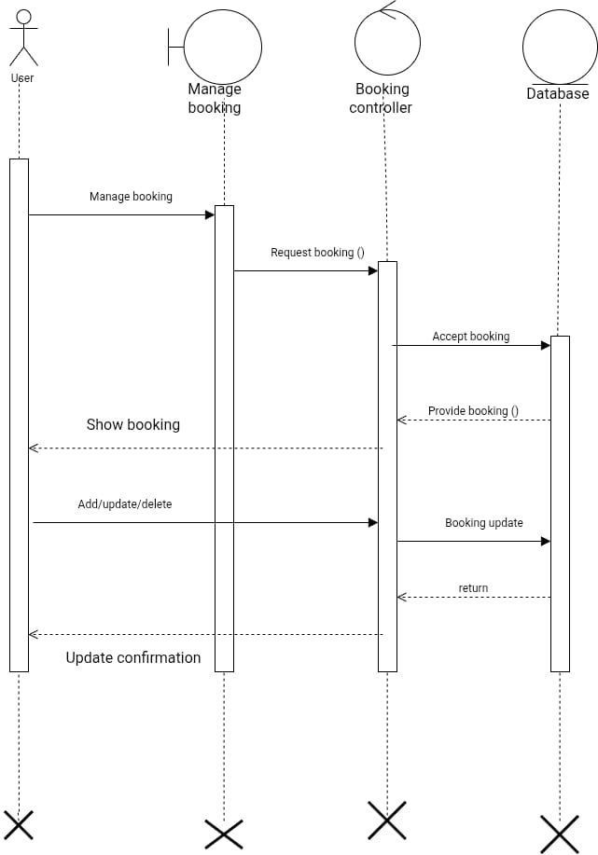
Manage Booking

Slide 20
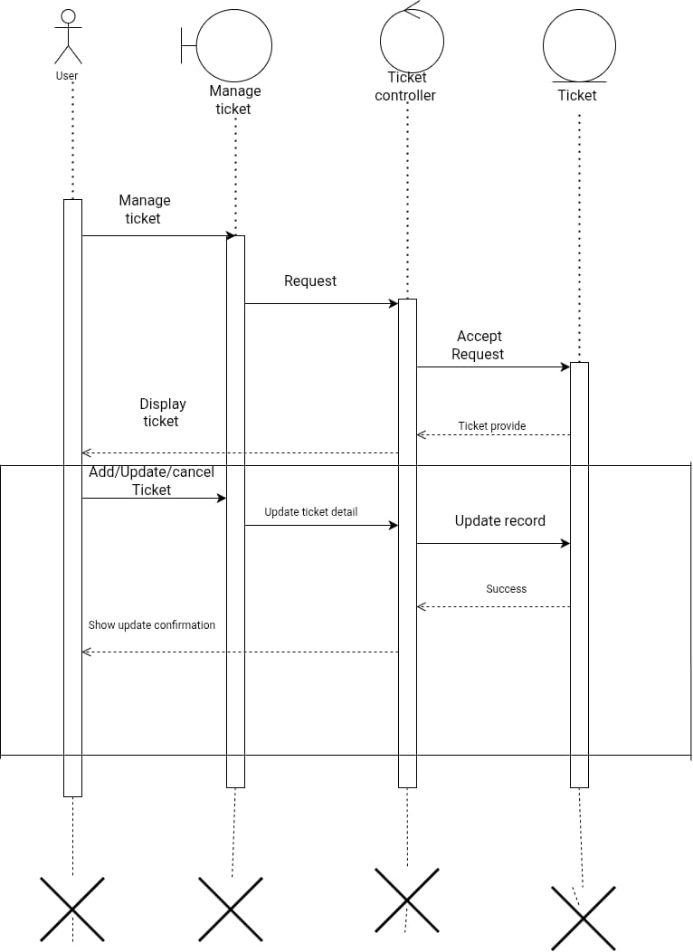
Manage ticket

Slide 21
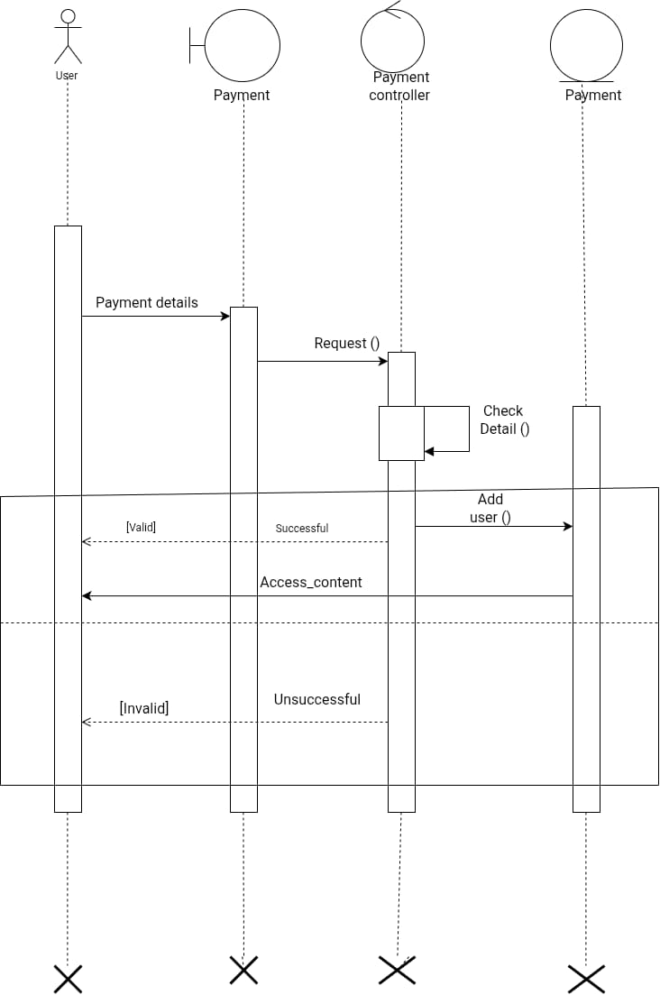
Payment

Slide 22
ACTIVITY DIAGRAM
❖ What is Activity Diagram?
Activity Diagram is one of the important diagrams of UML. It represents the flow from one activity to another activity which can be shown as operations of system.
An activity diagram portrays the control flow from a start point to a finish point showing the various decision paths that exist while the activity is being executed.
It represents what activities can be done in parallel and whether there are alternative paths through the workflow.
❖ Benefits of Activity Diagram:
Shows the progress of workflow amongst the users, and the system. It provides the visual representation of logic of a particular algorithm. It represents the relationship between one activity to another activity. It provides a better understanding of how the system works.
We can use Activity diagrams to depict concurrent activities easily.

Slide 23



Symbols of Activity diagram
Start / Initial point
Represents the beginning of the process.
End point
Represents the completion of all the flow and end of process.
Activity
Indicates the main activity with small description within the shape.
Activity flow
Shows the directional flow of the activity.
Decision symbol
Represents decision making with one input and multiple output.

Slide 24
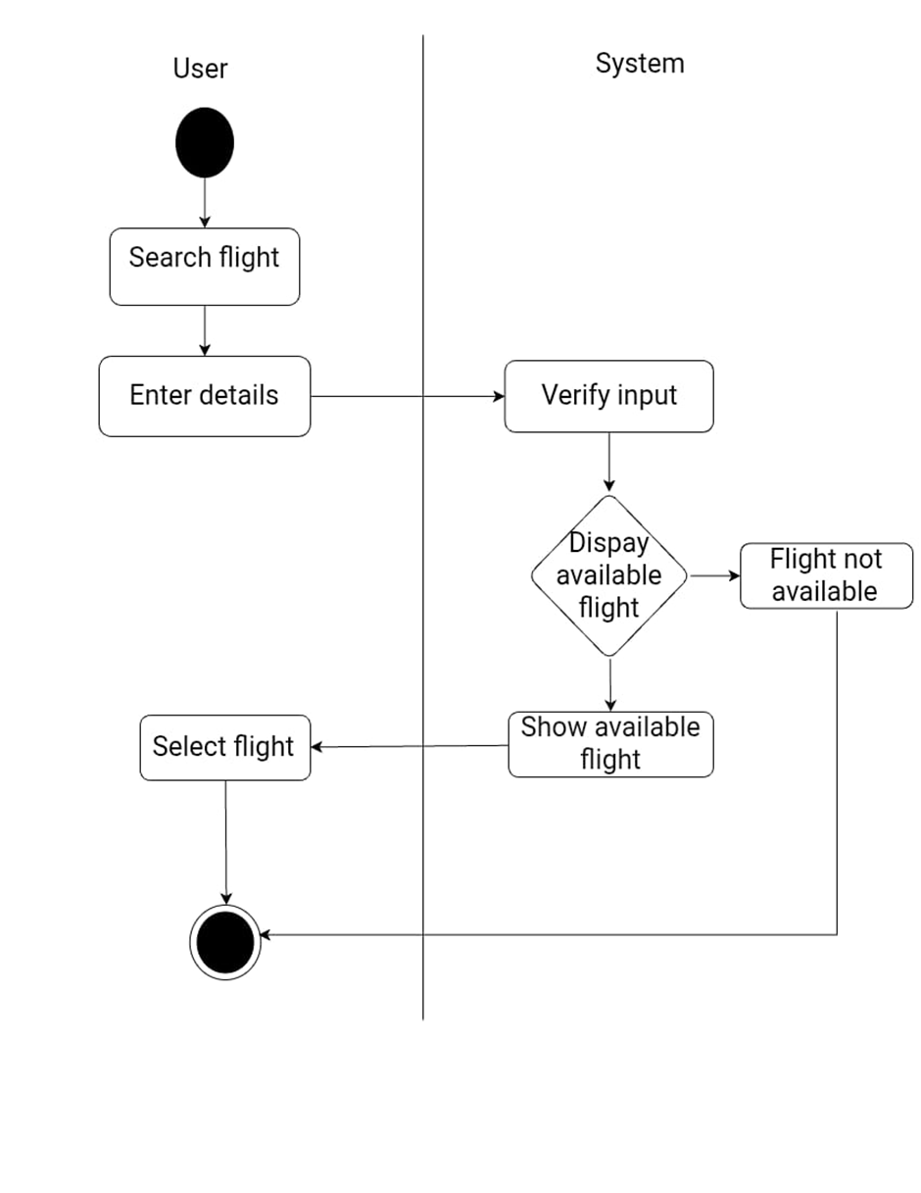
Search flight

Slide 25
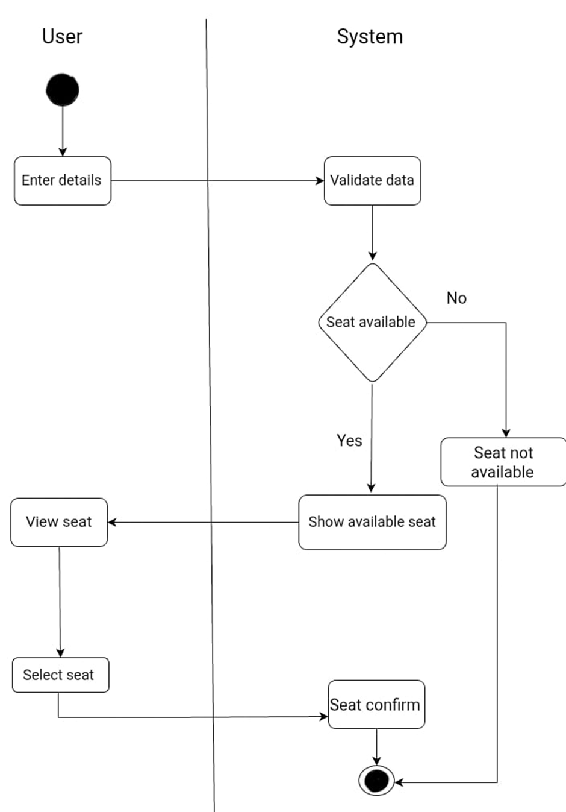
Seat selection

Slide 26
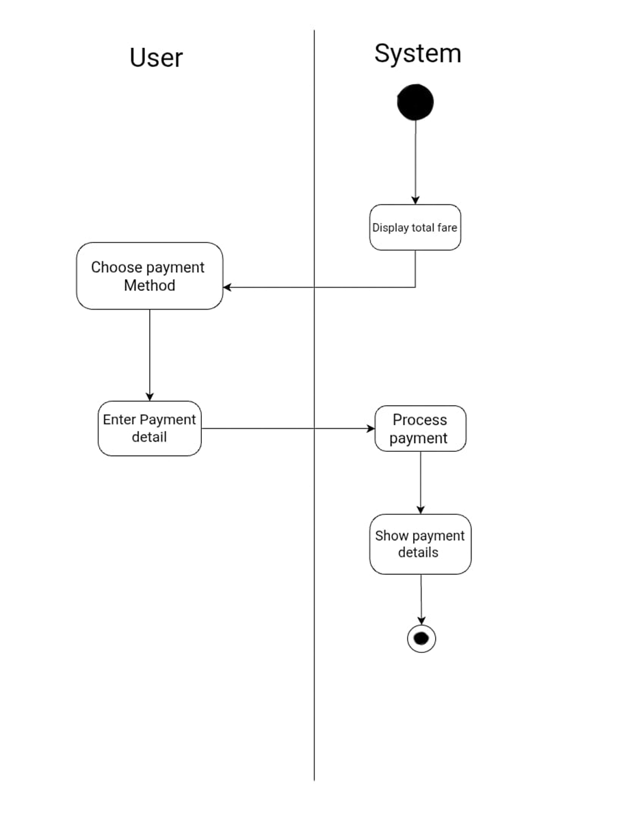
Payment

Slide 27
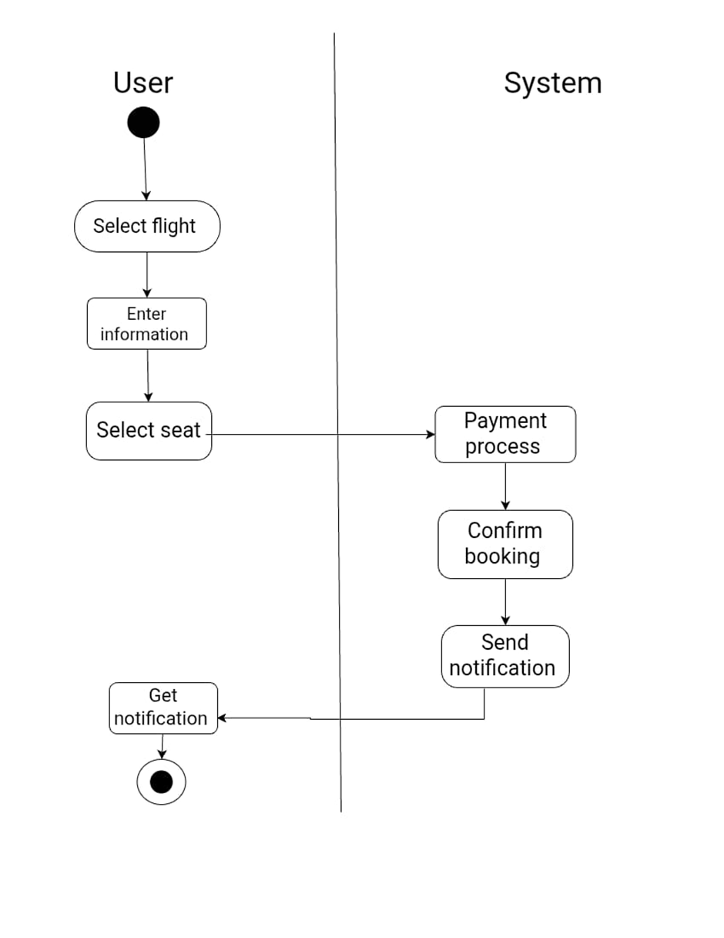
Booking

Slide 28
CLASS DIAGRAM
Class diagrams are one of the most useful types of diagrams in UML as they clearly map out the structure of a particular system by modeling its classes, attributes, operations, and relationships between objects.
Class diagrams contain icons representing classes, interfaces, and their relationships.
Since classes are the building block of objects, class diagrams are the building blocks of UML.
The class shape itself consists of a rectangle with three rows. The top row contains the name of the class, the middle row contains the attributes of the class, and the bottom section expresses the methods or operations that the class may use.
Classes and subclasses are grouped together to show the static relationship between each object.
BASIC COMPONENTS OF CLASS DIAGRAM:-
Upper Section
Middle Section
Bottom Section

Slide 29
MEMBER ACCESS MODIFIERS:-
All classes have different access levels depending on the access modifier(visibility). Here are the access levels with their corresponding symbols:
Public (+)
Private (-)
Protected (#)
Derived (/)
Static (underline)

Slide 30
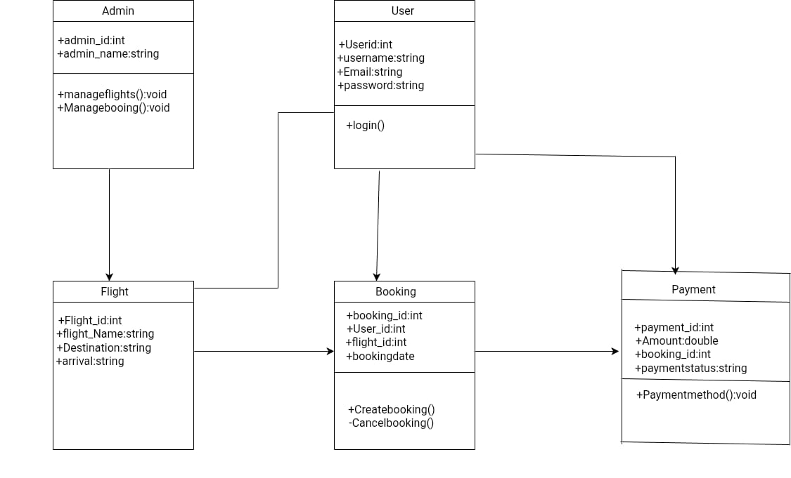
CLASS DIAGRAM

Slide 31
SYMBOL OF E-R DIAGRAM (ENTITY RELATIONSHIP DIAGRAM)
ENTITY
Represents real-world objects or concept in a database. Ex.supplier,customer.
ATTRIBUTES
Attribute provide additional information about entities .Ex.product attribute(name,price)
KEY-ATTRIBUTE
Denotes the arribute within an entity that uniquely identify instance of the entity. Typically underlines an attribute to indicate its impotance.
KEY-

Slide 32
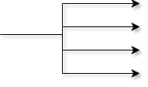
RELATIONSHIP
A relatioonship where a entity is exitance-independent of other entities,and PK of child dosen’t contain PK component of parent entity.
CARDINALITY
Specifies the number of instances or relationships between entities.common notations include ”1”(one),”0”(zero),”M”(many),”N”(avariable number).

Slide 33
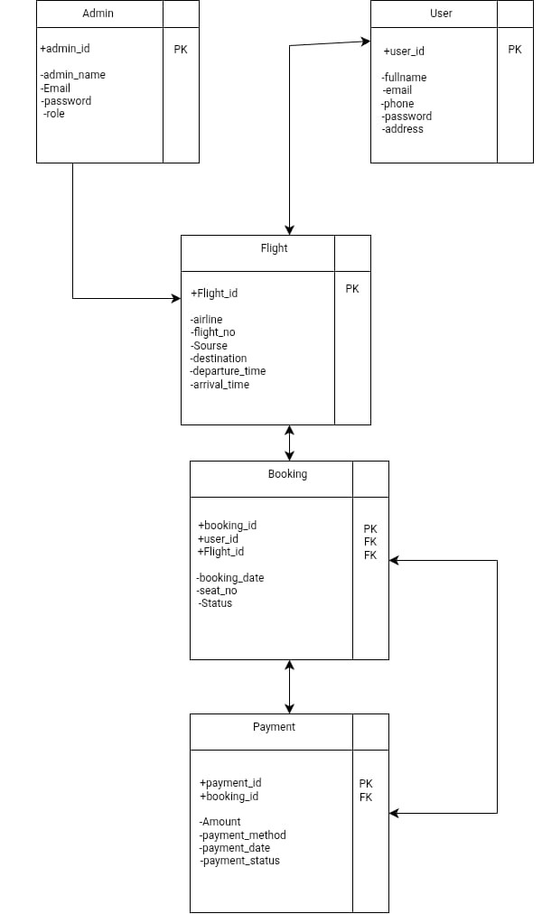
E-R DIAGRAM (ENTITY RELATIONSHIP DIAGRAM)

Slide 34
DATA DICTIONARY
1. Admin Table
Field Name | Data type | Size | Constraints | Description
Admin_id | INT | 5 | PK,Auto increment | Unique ID for admin
Admin_name | VARCHAR | 50 | Not null | Admin full name
Email | VARCHAR | 50 | Unique | Login email
Password | VARCHAR | 100 | Not Null | Login password
Role | VARCHAR | 20 | Default: staff | Type of admin

Slide 35
2. flight table
Field Name | Data type | Size | Constraints | Description
Flight_id | INT | 10 | PK,Auto increment | Unique ID of flight
Flight_number | VARCHAR | 20 | unique | Uniqueflight number
Source | VARCHAR | 50 | Not null | From location
Destination | VARCHAR | 50 | Not null | To location
Departure_detetime | DATETIME | - | Not null | Departure time
Arrival_datetime | DATETIME | - | Not null | Arrival time
Total_seats | INT | 5 | Not null | Total seats
Available_seats | INT | 5 | Not null | Seats available

Slide 36
3. user table
Field name | Data type | Size | Constraints | Description
User_id | INT | 10 | PK,Auto increment | Unique user ID
Full_name | VARCHAR | 100 | Not null | Passenger name
Email | VARCHAR | 100 | Unique | User email
Phone | VARCHAR | 15 | Not null | User phone number

Slide 37
4. booking table
Field Name | Data type | Size | Consatraints | Description
Booking_id | INT | 7 | PK, Auto increment | Unique booking ID
User_id | INT | 5 | Fk-user (user_id) | User reference
Flight_id | INT | 10 | FK- flight (flight_id) | Flight reference
Booking_date | DATETIME | - | Not null | Date of booking
Seat_count | INT | 3 | Not null | Number of seats booked
status | VARCHAR | 20 | Default: confirmed | Booking status(confirmed/cancelled)

Slide 38
5.payment table
Field Name | Data type | Size | Consatraints | Description
Payment_id | INT | 5 | PK , Auto increment | Unique payment ID
Booking_id | INT | 5 | Fk-Booking(booking_id) | Booking reference
Amount | DECIMAL | 10,2 | Not null | Ticket amount
Payment_method | VARCHAR | 50 | Not null | UPI/Card/NetBanking
Payment_date | DATETIME | - | Not null | Date of payment
Payment_status | VARCHAR | 20 | Dafault : Success | Success/Failed/pending

Slide 39
Thank you

